Slide 1


Capstone Project Phase A Denoising using Noise-to-Noise
Supervisor:
Miri Weiss Cohen
Submitters:
Or Man
Liad Yadin

Slide 2

Course Outline
Introduction
Background and Related Work
Encoder-Decoder CNN
CT Noise
Denoising
Expected Achievements
Research Process
Product
Verification Plan

Slide 3
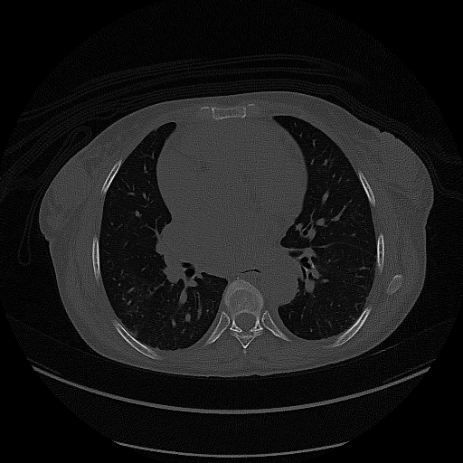
Introduction
Noise in CT image can cause:
Sizing issue.
Material misdiagnosis.
Small feature disappearing.
Image quality mainly depends on the patient's exposure during the scan.
Poor countries need.
Limited clean dataset.

Slide 4
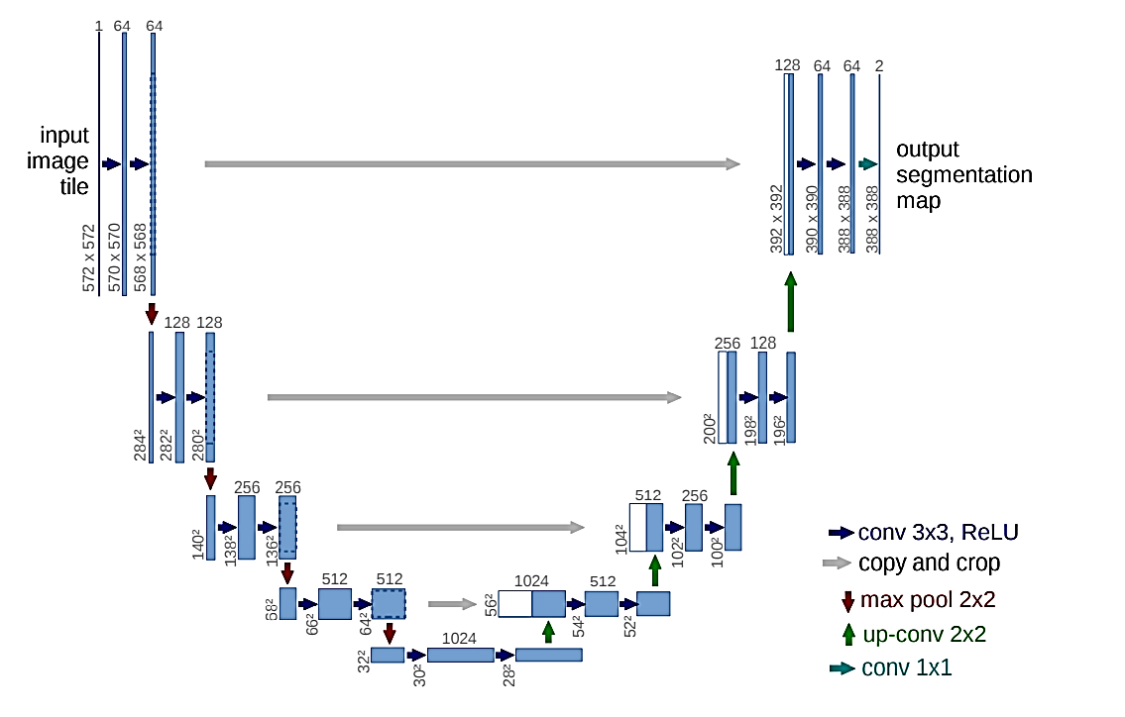
Background and Related Work Encoder-Decoder CNN
Encoder Decoder
Convolution layers
Max pooling layers
Up-convolution layers
Copy and Concatenate

Slide 5
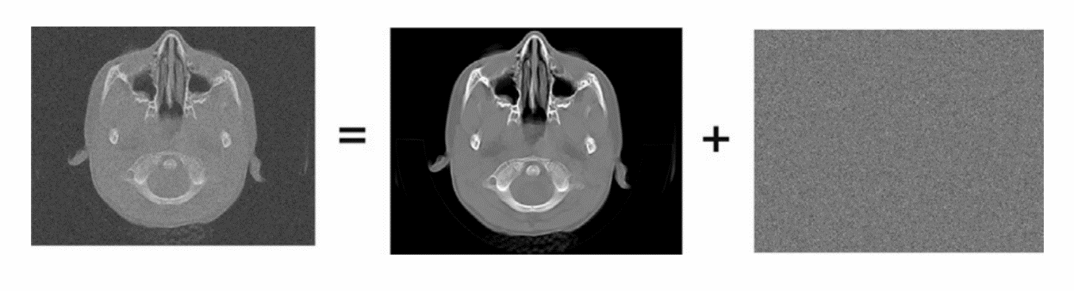
Background and Related Work CT Noise

Slide 6
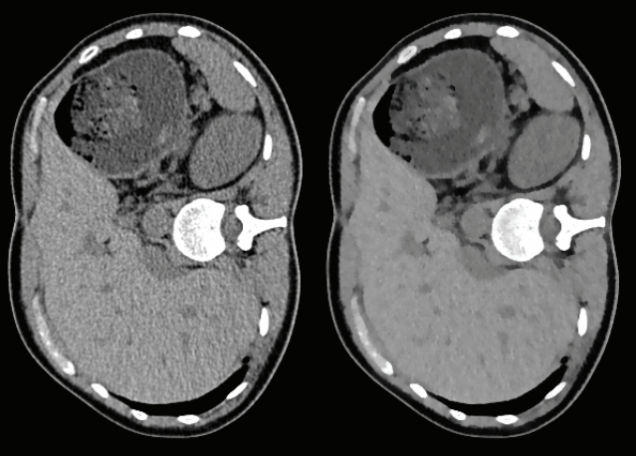
Background and Related Work CT Noise – Denoising
The main challenges for noise reduction in CT images are:
Flat regions should be flat.
Image boundaries should be preserved (no blurring).
Texture details should not be lost.
Global contrast should be preserved.
New artifacts should not be generated

Slide 7
Background and Related Work CT Noise – Denoising
Filters
Smoothening and Sharpening filters
Machine Learning
“Standard" Noise2Clean
Noise2Noise
Learning to produce clean images by looking on noisy and clean pair of the same image.
In the next slide

Slide 8

Background and Related Work CT Noise – Denoising – Noise2Noise
Noise is hard to recreate, so average noise is reproduced.
Small Dataset solution:
$DataSetSize= I⋅\left(N⋅\left(N−1\right)\right)$
$I −number of different images.$
$N−number of noisy instances of every image.$
Data augmentation to increase even more the dataset.
The results are in the same range as Noise2Clean (and even higher).

Slide 9
Expected Achievements
We expect to build a system that will be able to denoise a CT image with better accuracy than other available methods.
Build a network based on the Encoder-Decoder CNN with our modifications.
Create a network that can be trained using the available medical data.
A system that can reduce noise by a factor of 10-15%.
Find the best values for the hyperparameters.

Slide 10
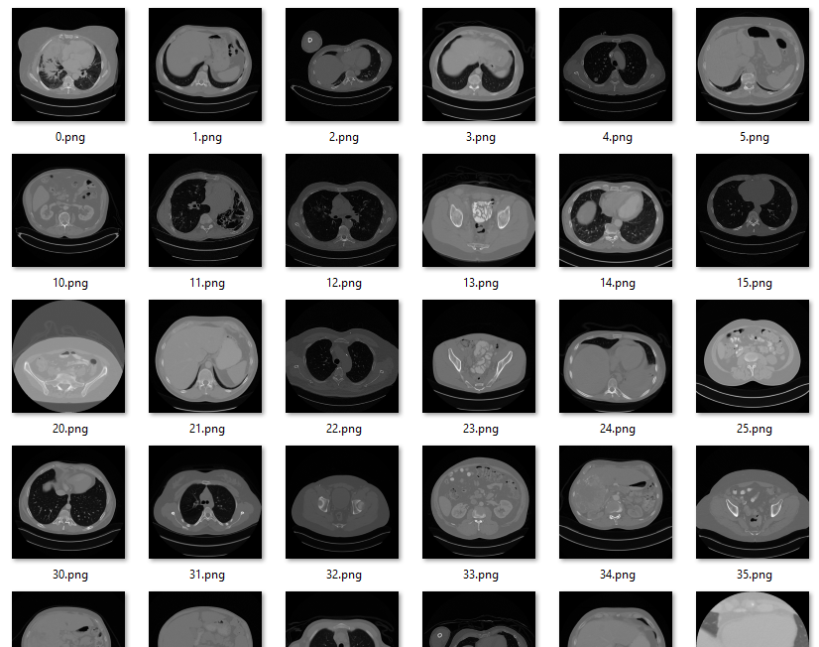
Research Process Dataset
“DeepLesion” dataset.
32,735 images from 4,400 patients.
The dataset is normalized.
Noise is added on the fly.
Noise is “Additive White Gaussian Noise” (AWGN)
AWGN has normal distribution with zero mean.

Slide 11
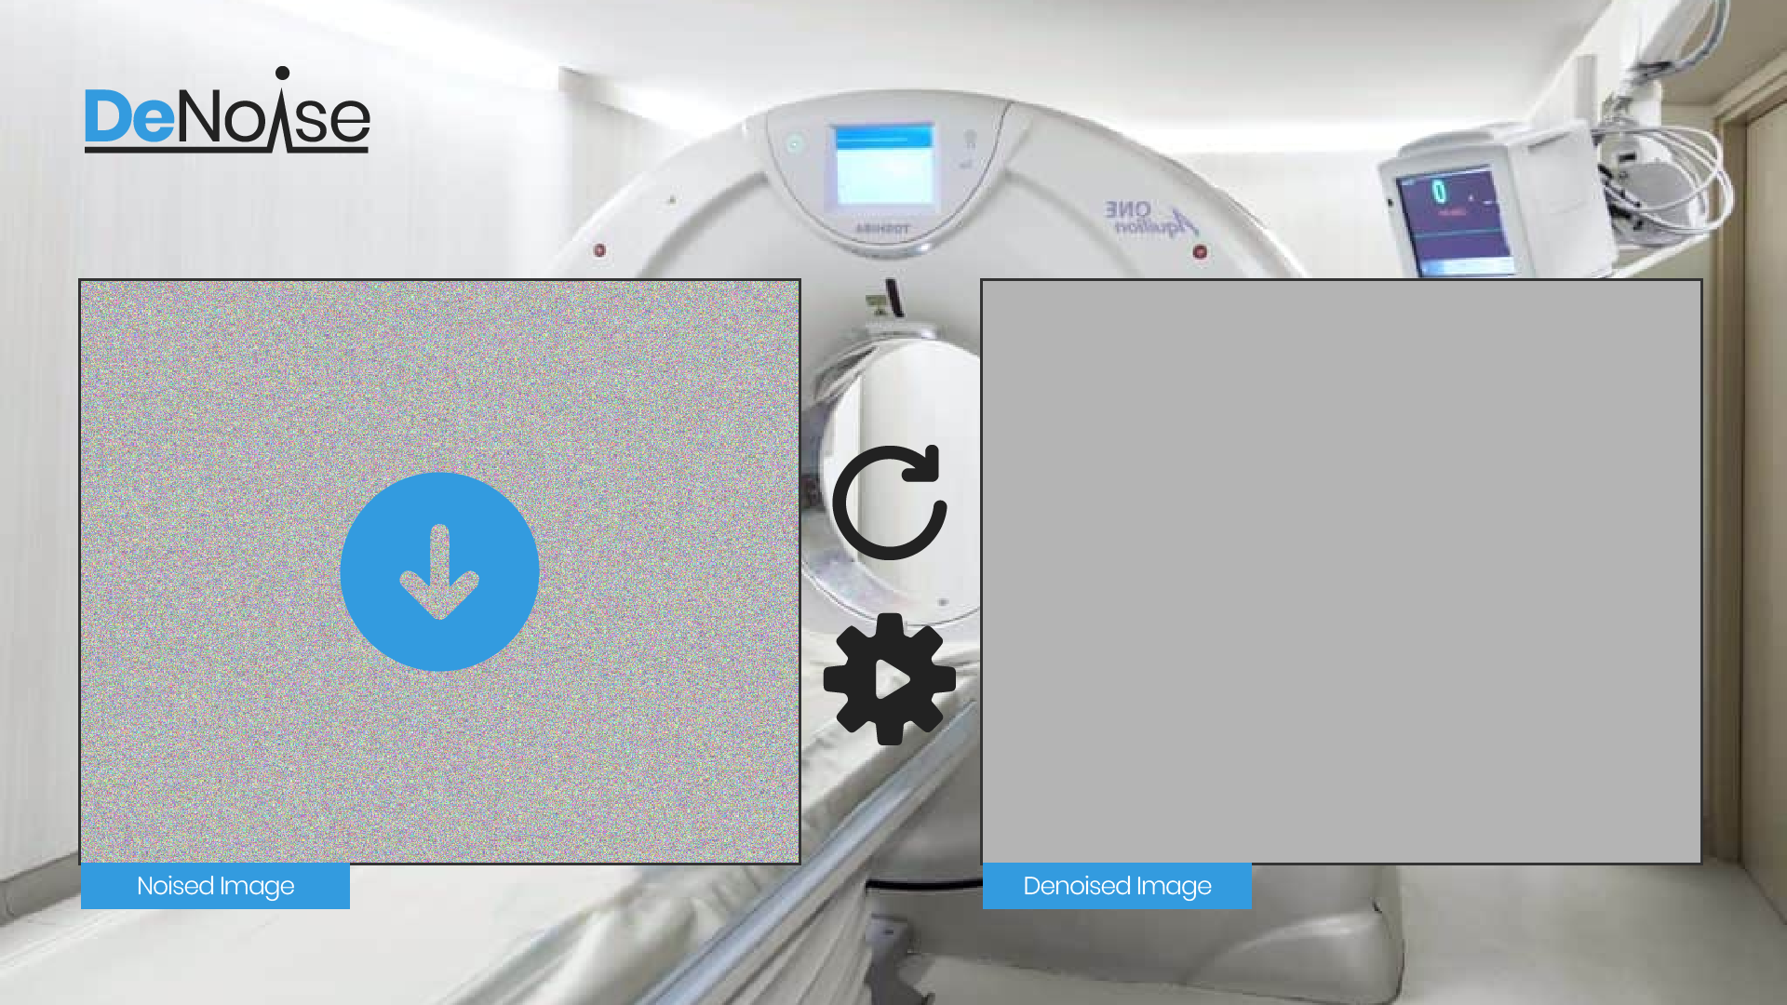
Product - GUI

Slide 12
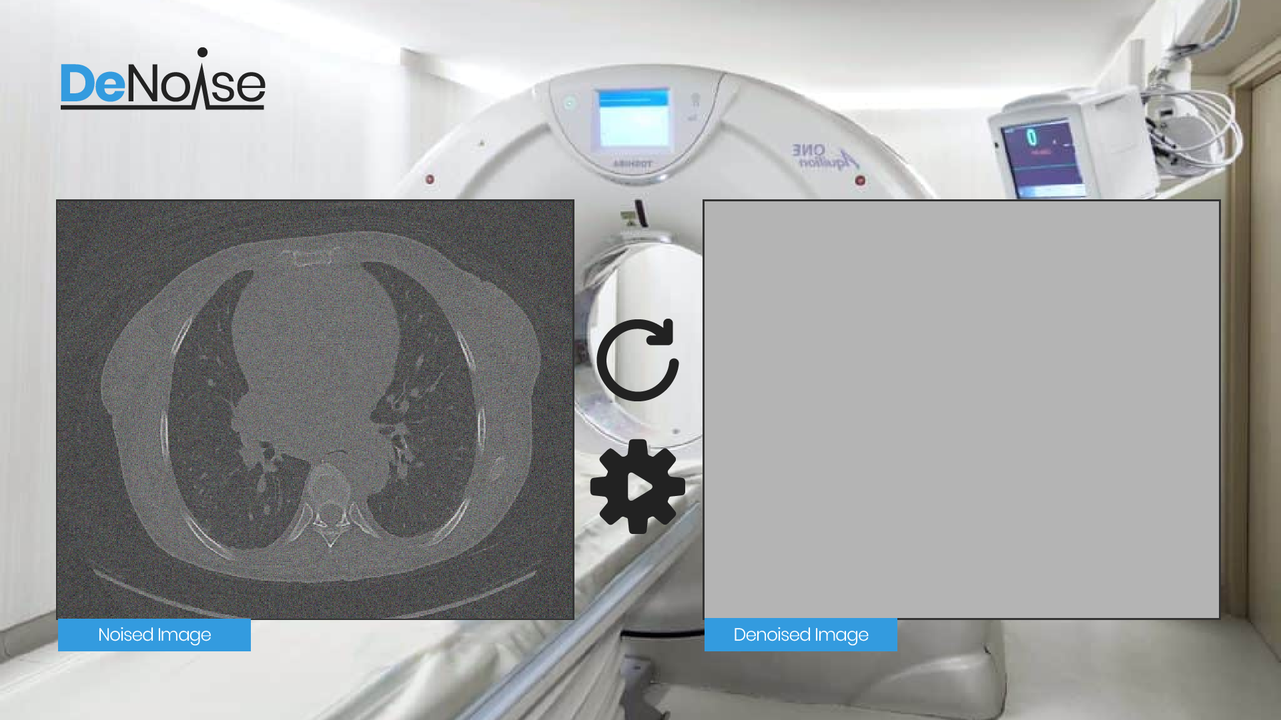
Product - GUI

Slide 13
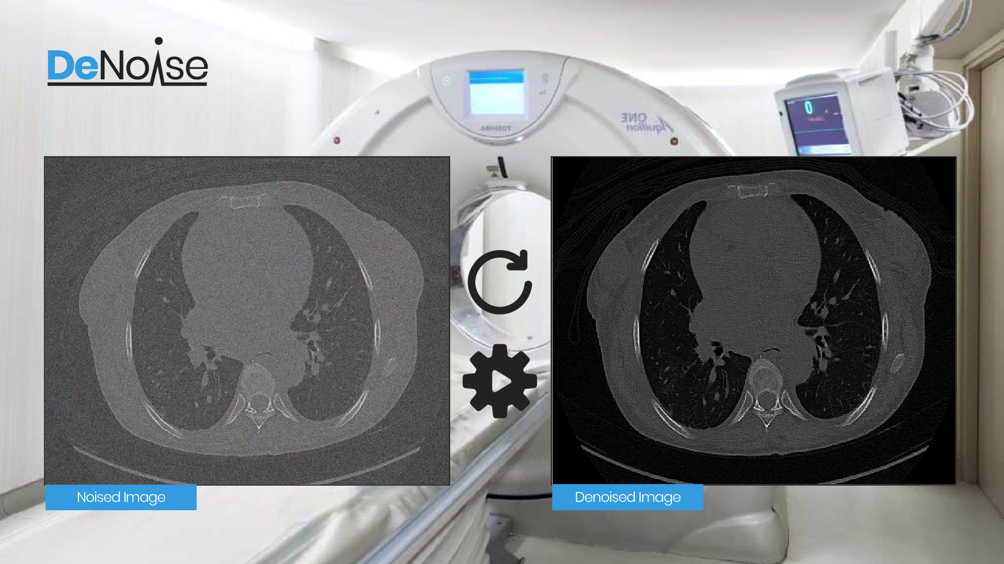
Product - GUI

Slide 14
Verification Plan
Expected result | Test case | Case number
Error message: "Wrong format" | Insert wrong picture format | 1
The system will denoise the picture | Insert expected picture format | 2
Error message: "Insert picture" | Press "Denoise CT scan" without inserting a picture | 3
The system will denoise the picture | Press "Denoise CT scan" after inserting a picture | 4
Back to the main window | Press "back" | 5

Slide 15
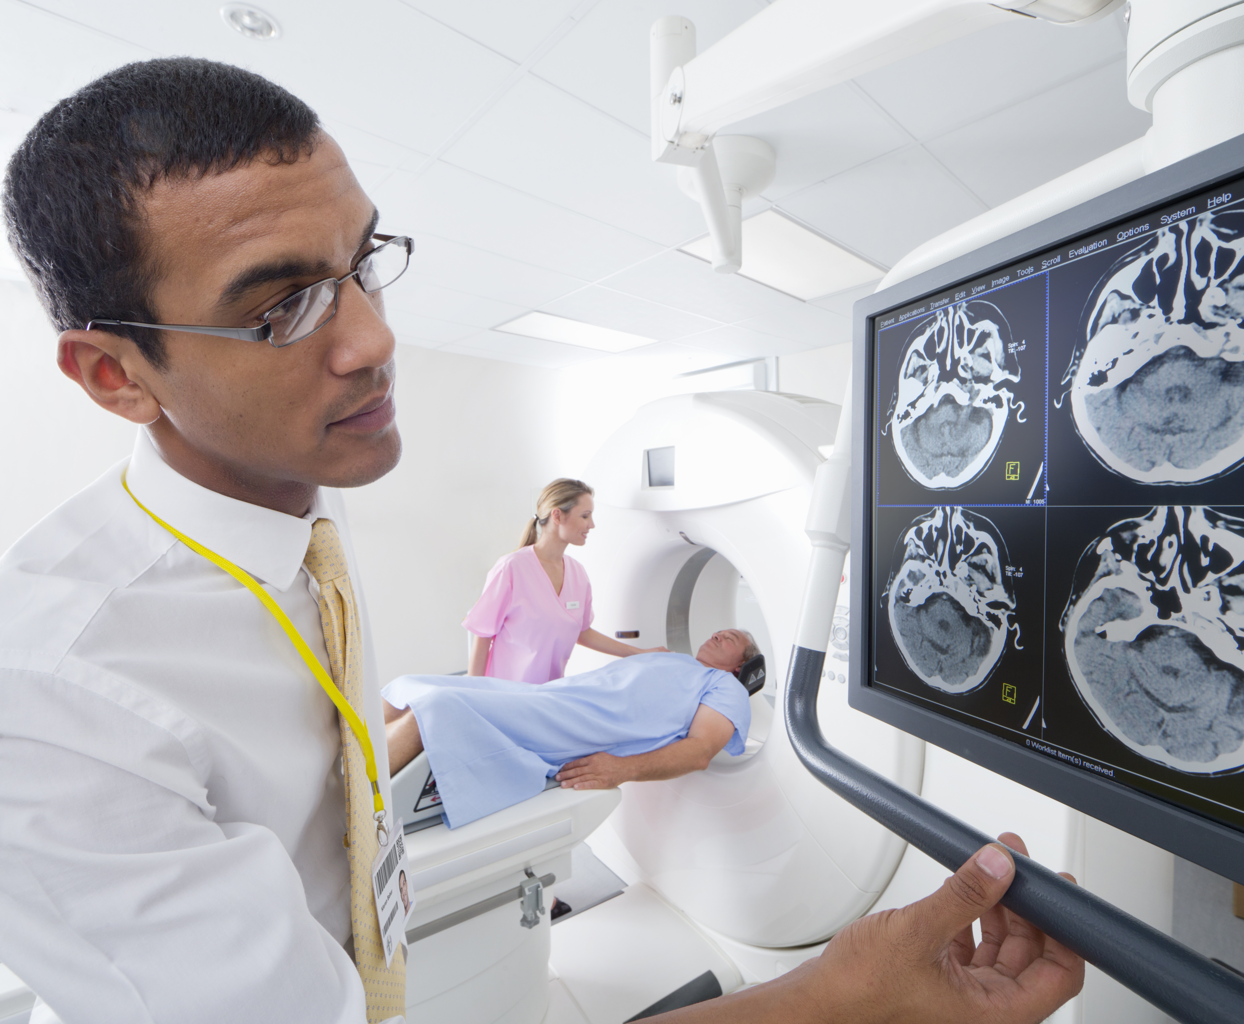
Questions?

